Slide 1
Adaptor
The translator object

Slide 2

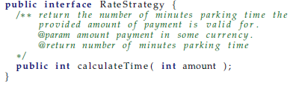
Motivation
LunaTown requirement
  The rate should correlate the phases of the moon !
    Double rates at full moon ☺
  You must use the implementation bought from a consultancy company (closed source!)
Challenge:
  The interface does not match ours ☹

Slide 3
③-①-②
③-①-②: We have done almost all the steps
  ③: Encapsulate what varies (rate calculations)
  ①: We have the RateStrategy interface
But we cannot ② because the provided rate calculator does not implement RateStrategy!
But we can ② compose behavior even further to solve the problem

Slide 4
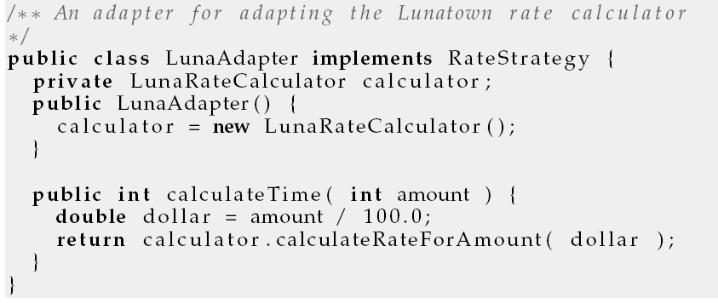
Solution
I will put an intermediate object between the two, one that does the translation from one interface to the other:

Slide 5
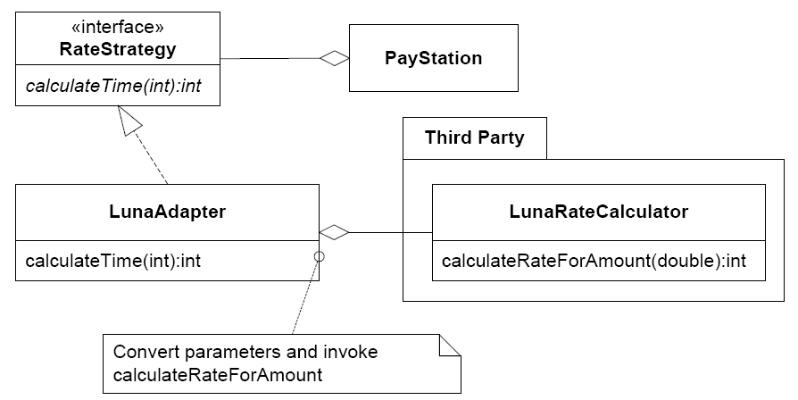
Structure of our solution

Slide 6
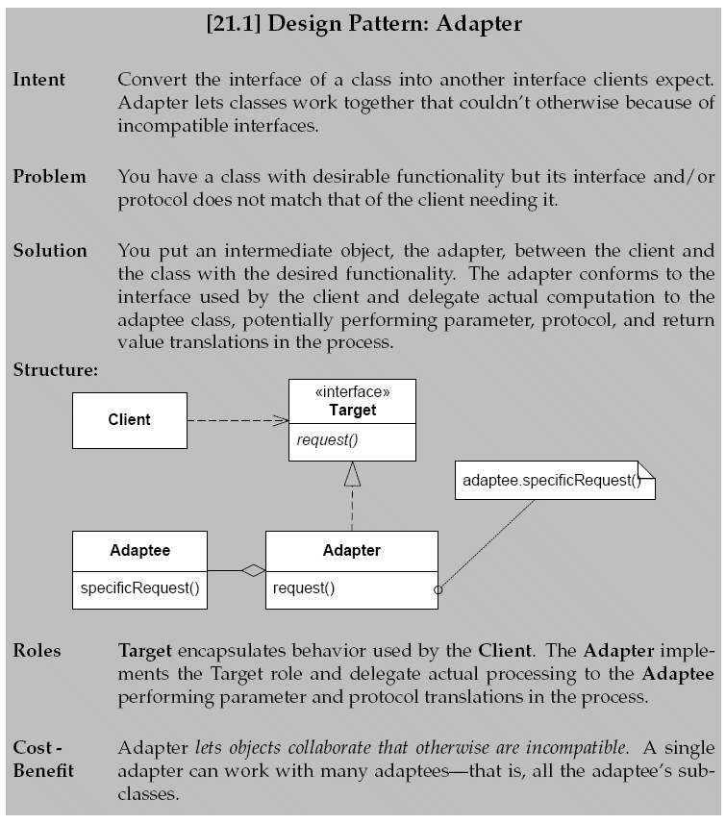

Slide 7
Consequences
Benefits
  Makes a client work with an otherwise incompatible object
  One adapter can adapt many type of adaptee’s namely all subclasses
Liabilities
  Adaptation spectrum: from simple method name conversions to radically different interfaces
    Adapters for gui toolkits

